Slide 1
Module 4.3:
Privacy
Philosophy, Policy, and Technology
ML for Cybersecurity

Slide 2
Adversaries
Ethics
Attacker’s goals
Attacker’s capabilities
Robustness of model/feature
Privacy
Fairness
Transparency
Modules 2 – 4
Module 4
Module 2
Module 1
Identify Goals & Collect Data
Data Representation
Modeling
Deployment
Pinpoint needs
Data acquisition
Data labeling
Data exploration
Data cleaning
Missing data
Feature selection
Consider fairness
Efficiency
Accuracy
Interpretability
Adversarial resistance
Performance
Evasion and attacks
Model drift
Impact on stakeholders
Module 3

Slide 3
Adversaries
Ethics
Attacker’s goals
Attacker’s capabilities
Robustness of model/feature
Privacy
Fairness
Transparency
Modules 2 – 4
Module 4
Module 2
Module 1
Identify Goals & Collect Data
Data Representation
Modeling
Deployment
Pinpoint needs
Data acquisition
Data labeling
Data exploration
Data cleaning
Missing data
Feature selection
Consider fairness
Efficiency
Accuracy
Interpretability
Adversarial resistance
Performance
Evasion and attacks
Model drift
Impact on stakeholders
Module 3

Slide 4
Privacy is Hard to Define
“Privacy is a value so complex, so entangled in competing and contradictory dimensions, so engorged with various and distinct meanings, that I sometimes despair whether it can be usefully addressed at all.” Robert C. Post, Three Concepts of Privacy, 89 Geo. L.J. 2087 (2001)

Slide 5
Defining Privacy

Slide 6
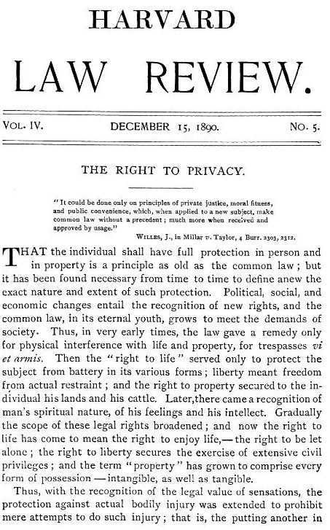
The Right to Be Let Alone
Warren and Brandeis, Harvard Law Review, 1890
Spurred by photography in gossip pages about high society
Libel and slander are insufficient in considering only damage to reputation
The right to prevent, rather than profit from, publication
Excludes topics of general interest

Slide 7
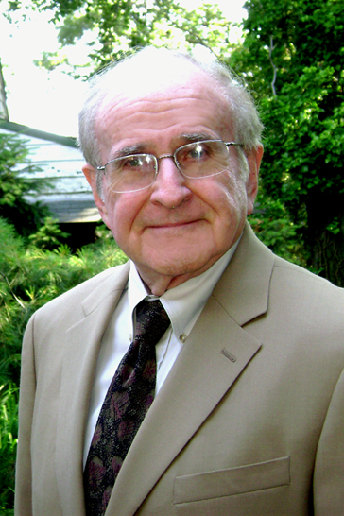
Privacy as Control
Alan Westin, Privacy and Freedom, 1967
“Privacy is the claim of individuals, groups or institutions to determine for themselves when, how, and to what extent information about them is communicated to others”
“…personal adjustment process… balances the desire for privacy with the desire for disclosure and communication….”

Slide 8
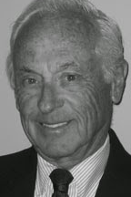
Boundary Regulation
Irwin Altman, 1975
Privacy is a dialectic and dynamic process of boundary regulation
Goal: optimize balance of privacy and social interaction

Slide 9
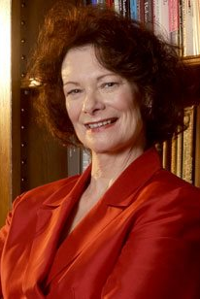
Balance Costs and Benefits
Sandra Petronio, 1991
Communication Privacy Management (CPM) Theory
Regulate boundaries based on perceived costs and benefits
Rule-based management is expected
Boundary turbulence related to clashing expectations

Slide 10

Contextual Integrity
Helen Nissenbaum, 2004
“Contextual integrity ties adequate protection for privacy to norms of specific contexts, demanding that information gathering and dissemination be appropriate to that context.”
Parameters: data subject, sender, recipient, information type, and transmission principle

Slide 11
Business Applications

Slide 12
Applying Privacy to Cybersecurity ML
You are building a model to detect fraudulent sign-in attempts
What features might you want to use in your model?
How do we think about the collection and use of user data for training the model if we define privacy in the following ways?
The right to be let alone (Warren/Brandeis)
Control (Westin)
Boundary regulation (Altman / Petronio)
Contextual integrity (Nissenbaum)

Slide 13
Privacy Regulation & LAW

Slide 14
Fair Information Practice Principles (FIPPs)
US Federal Trade Commission (FTC), building on earlier frameworks
Notice / Awareness
Choice / Consent
Access / Participation
Integrity / Security
Enforcement / Redress

Slide 15
FTC’s Regulatory Tools
Unfair practices
Injure consumer
Violate established policy
Unethical
Deceptive practices
Mislead consumer
Differ from reasonable consumer expectations

